Slide 1
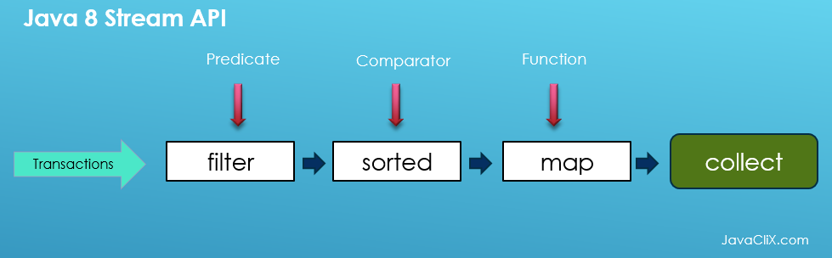
Java 8 Streams in details
By: Rehab Mohamed

Slide 2
Agenda
Streams overview.
What is the difference between Java 8 Streams and collections?
Is streams a data structure?
Streams operations.
Streams laziness & traversal.
Java 8 streams methods categorization.
Streams examples.

Slide 3
Streams overview
Stream API is only used for processing group of data. It does not modify the actual source (collection)and does not change the original data structure, they only provide the result as per the pipelined methods.
In short streams are not a new data structure its a way of processing.
Why streams?Streams are lazy because intermediate operations are not evaluated unless terminal operation is invoked. Each intermediate operation creates a new stream, stores the provided operation/function and return the new stream. streams don't evaluate streams 'one by one' (at terminal point).
Intermediate operations are lazy. This means that they will be invoked only if it is necessary for the terminal operation execution.
A stream pipeline is nothing but combined intermediate and terminal operations.

Slide 4
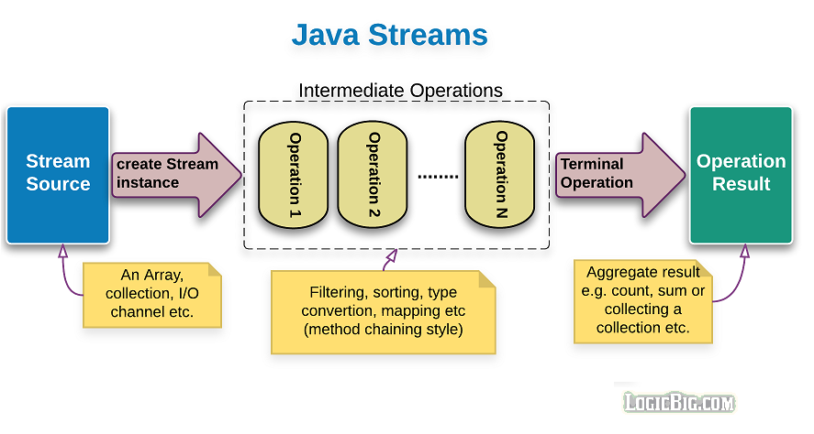
Streams overview
What is streams ?

Slide 5
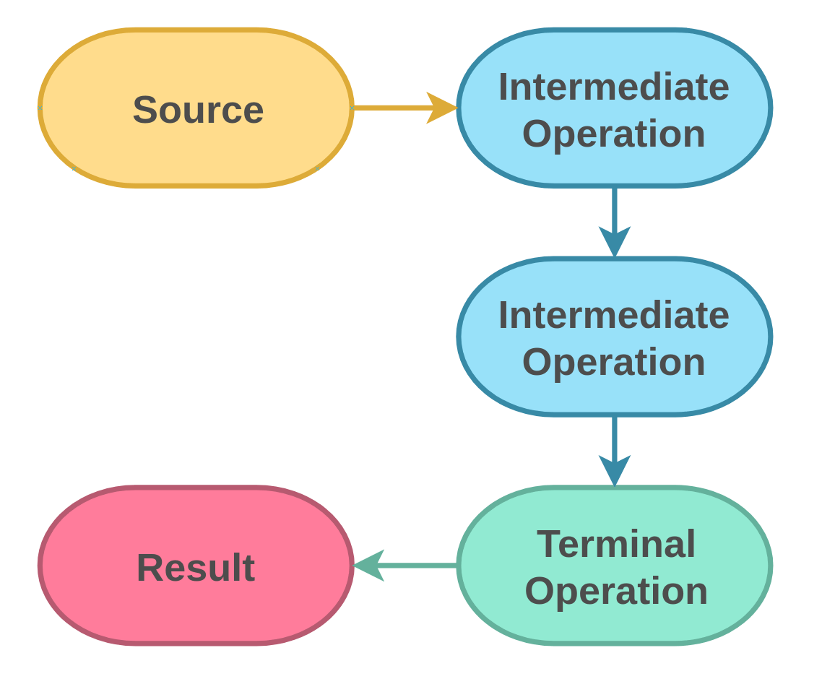
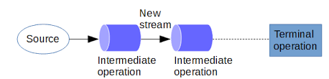
Stream operations
A stream life cycle can be divided into three types of operation:
Obtaining the instance of Stream from a source. A source might be an array, a collection, a generator function, an I/O channel, etc
Stream<String> stream = list.stream();
Zero or more intermediate operations which transform a stream into another stream, such as filtering, sorting, element transformation (mapping).
e.g. filter(), sorted(..), map(..),…..
A terminal operation which produces a result, such as count, sum or a new collection.
e.g. count(), max(..), distinct(...),toArray(..), collect(..) ,forEach(..).

Slide 6
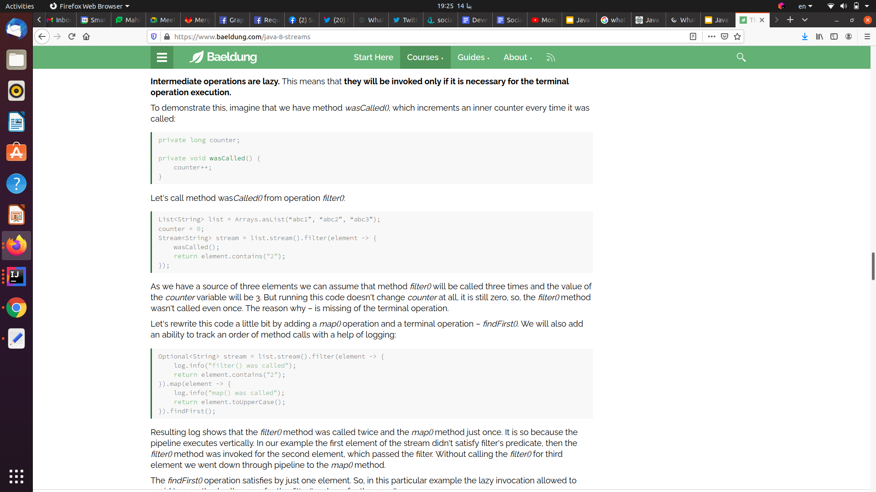
Stream laziness

Slide 7
Collections Vs Streams
Difference Between Collections And Streams In Java:
Conceptual Difference:
both are conceptually two different things which are used for two different purposes. If the collections are used to store the data then the streams are used to perform operations on that data.
Collections are used to store and group the data in a particular data structure like List, Set or Map. But, streams are used to perform complex data processing operations like filtering, matching, mapping etc on stored data such as arrays, collections or I/O resources. That means, collections are mainly about data and streams are mainly about operations on data.
Data Modification
You can add to or remove elements from collections. But, you can’t add to or remove elements from streams.
External Iteration Vs Internal Iteration
Traversal
Streams are traversable only once. If you traverse the stream once, it is said to be consumed. To traverse it again, you have to get new stream from the source again. But, collections can be traversed multiple times.
Eager Construction Vs Lazy Construction

Slide 8
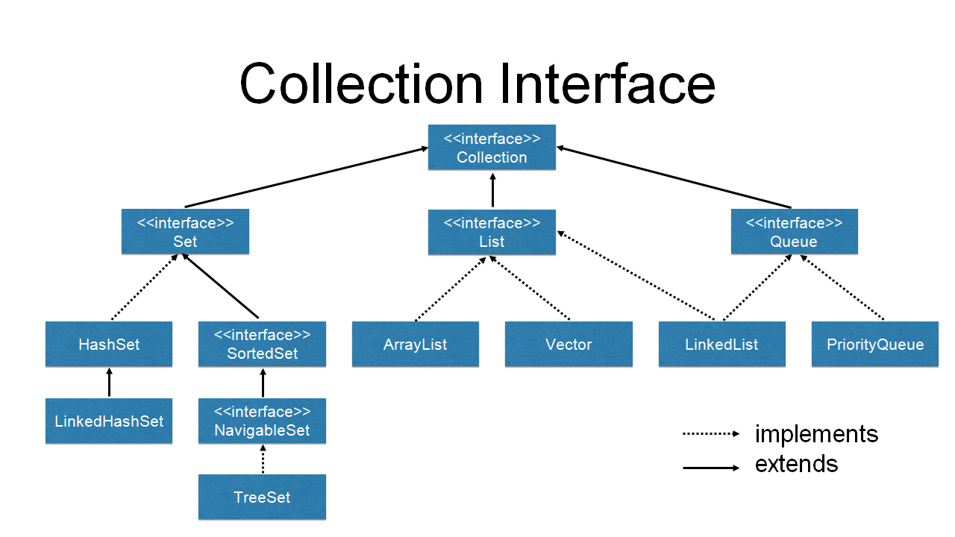

Slide 9
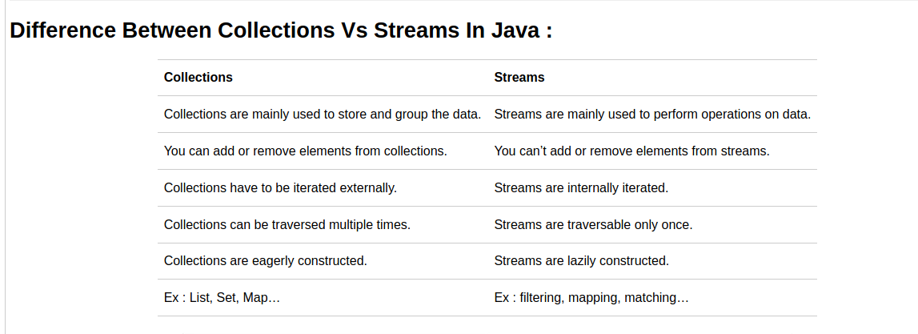
Collections Vs Streams
1-Conceptual
2-Manipulation
3-Type of iteration
4-Traversal
5-Laziness

Slide 10
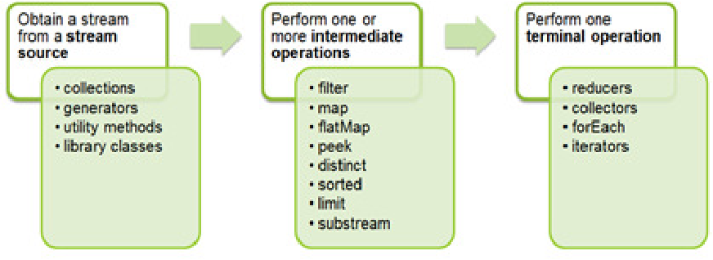
Stream operations categorization

Slide 11
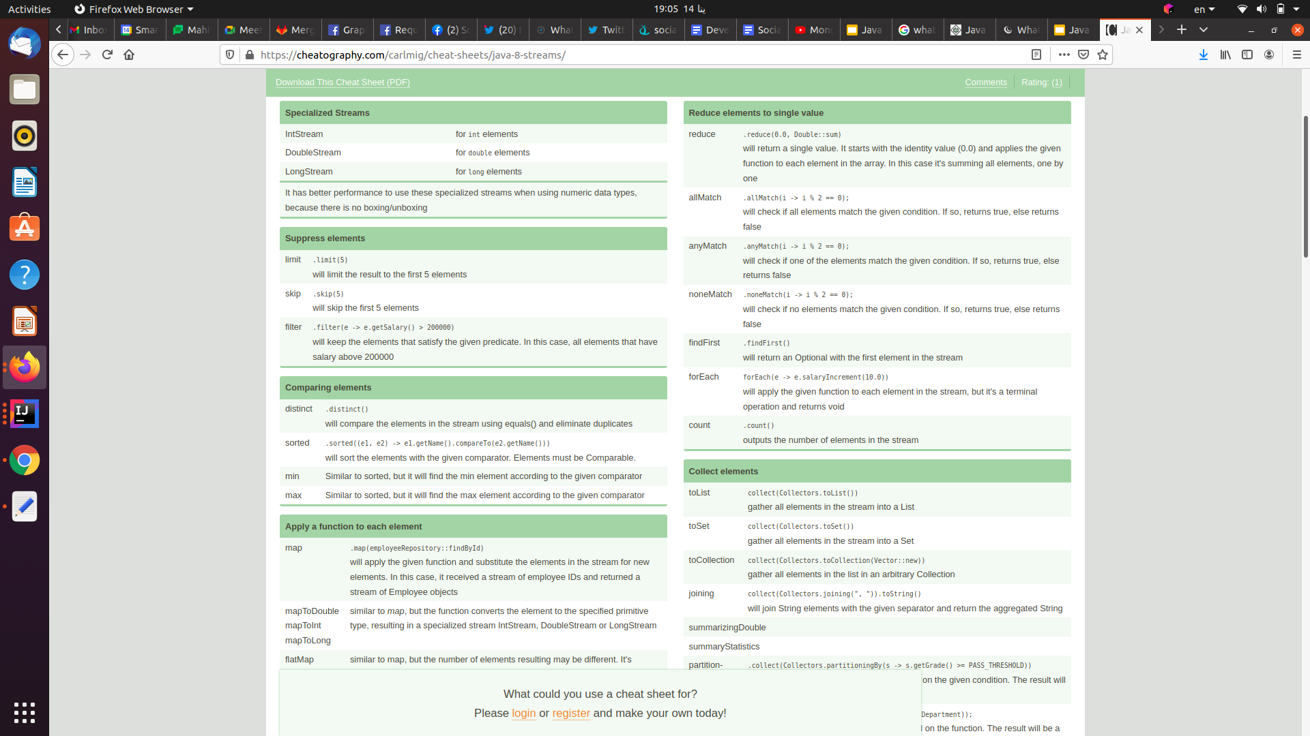
Streams functions cheat sheet

Slide 12
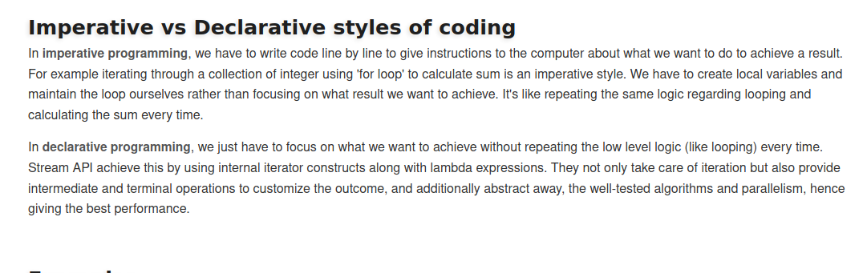
Imperative vs Declarative styles of coding

Slide 13
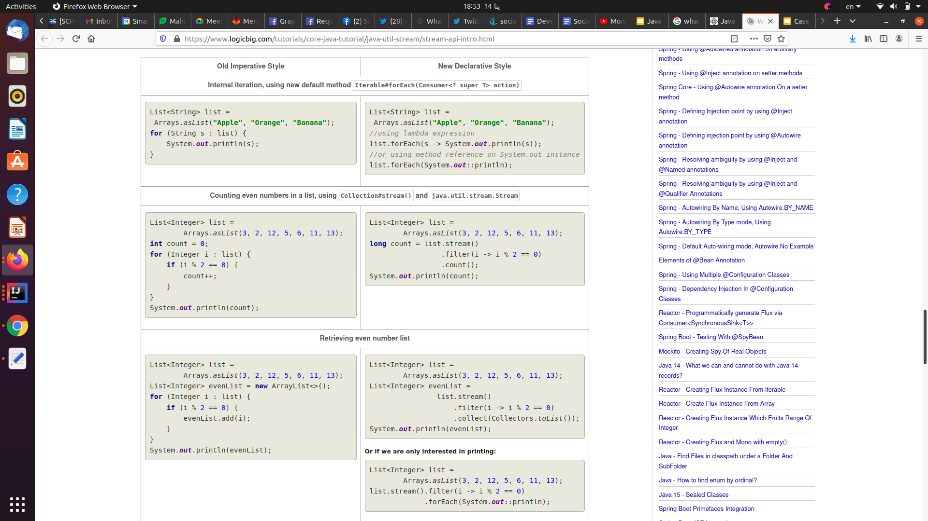
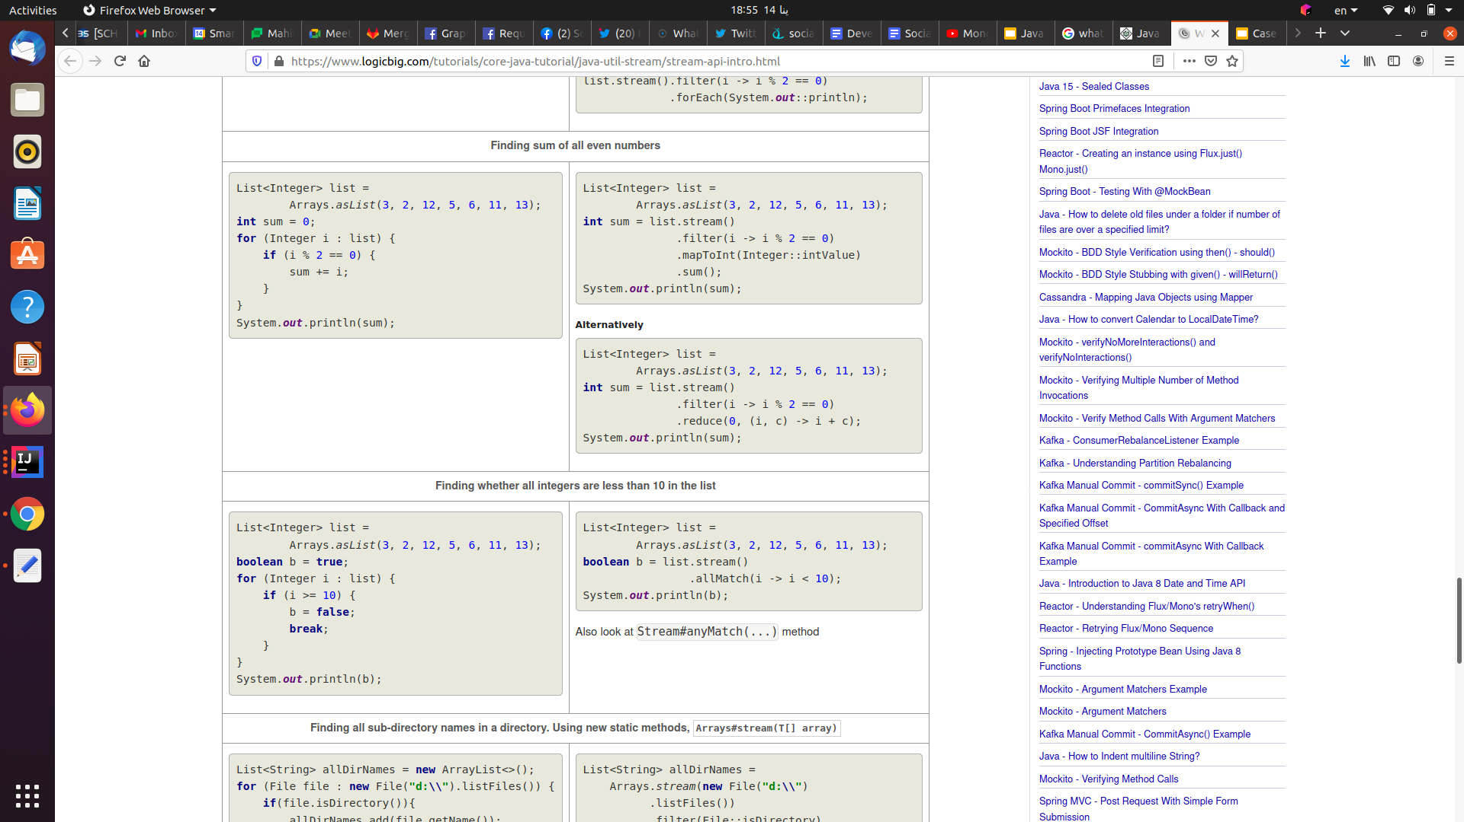
Imperative vs Declarative styles of coding

Slide 14
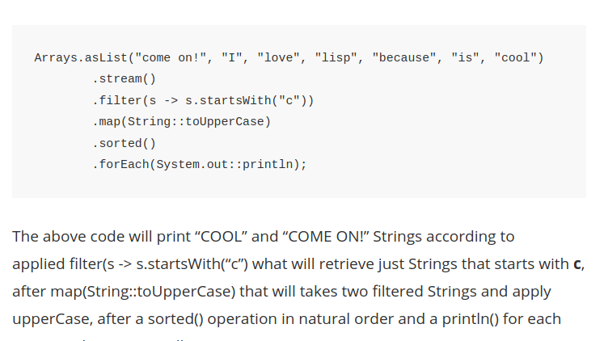
More streams and lambda expression examples
Get element of an array of strings that begin with “c” letter and make it capital:
//List<String> messagesList =Arrays.asList("come on!", "I", "love", "lisp", "because", "is", "cool")
The same example can be used for any methods defined for the string class like contain,endwith,.....

Slide 15
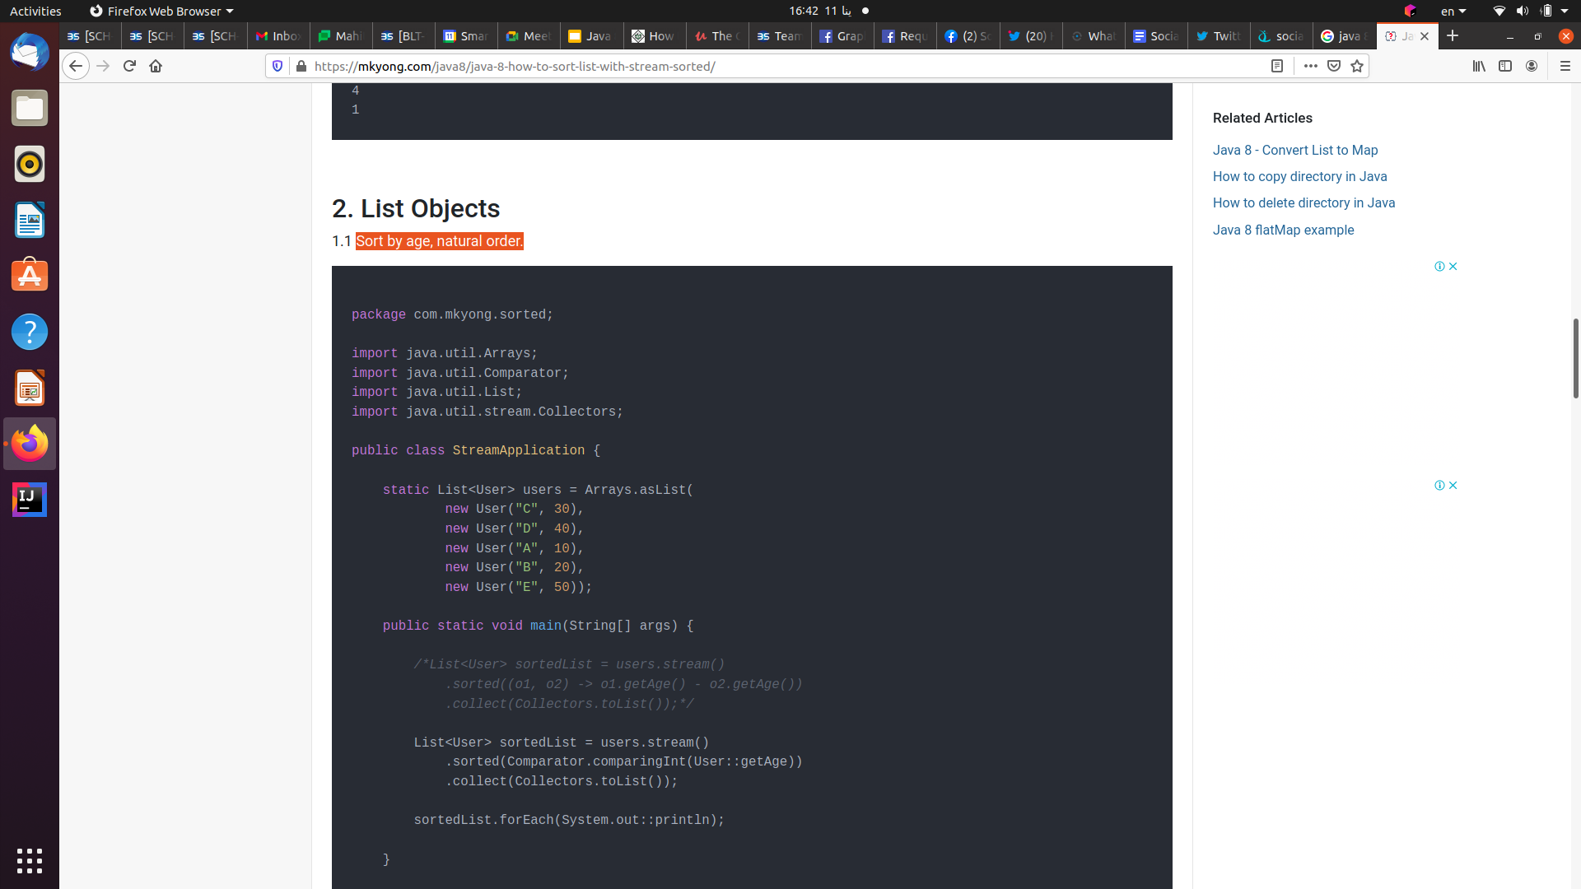
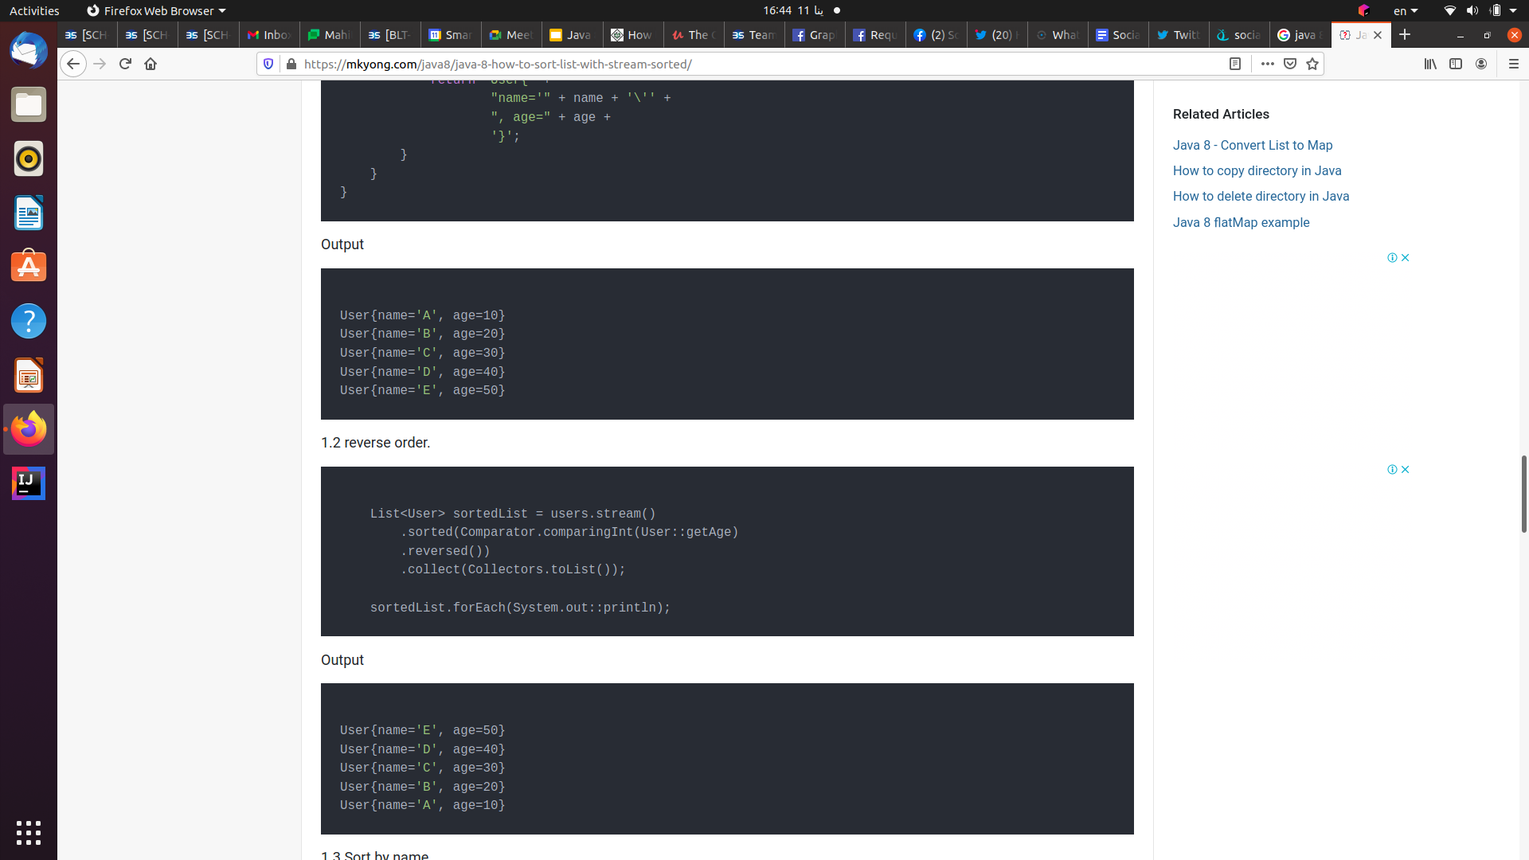
More streams and lambda expression examples
.
Example 1:
Sort by age,: Consider we have class user contains name,age
1-Natural order(Ascending)

Slide 16
More streams and lambda expression examples
.
Sort by age,: Consider we have class user contains name,age
2-Reverse order(Descending)

Slide 17
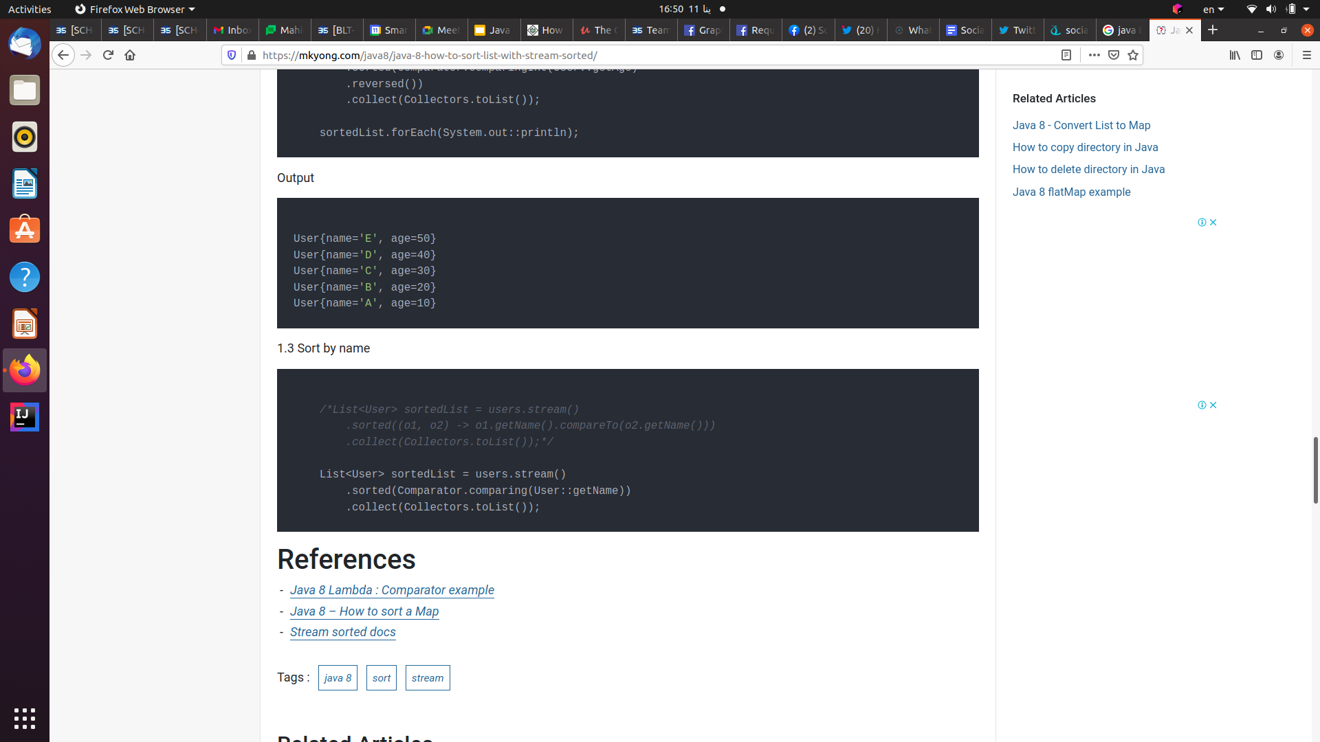
More streams and lambda expression examples
.
Sort by name: (default-Asc)

Slide 18
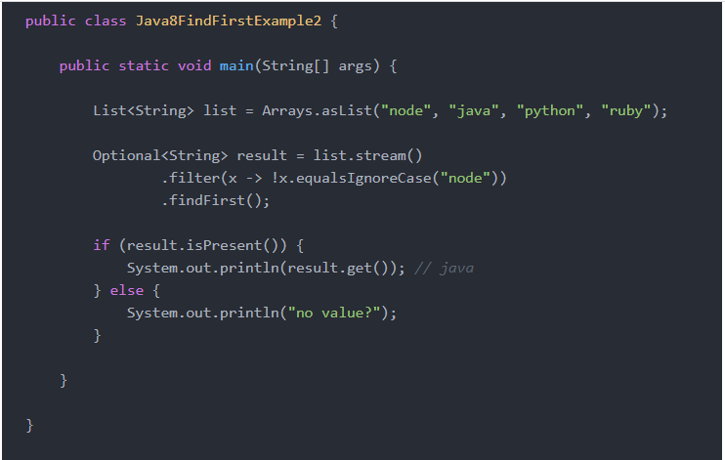
More streams and lambda expression examples
Example 2- find first:
Get first matching condition object in a list
Get last matching condition object in a list → the same just replace findFirst() with findLast();

Slide 19
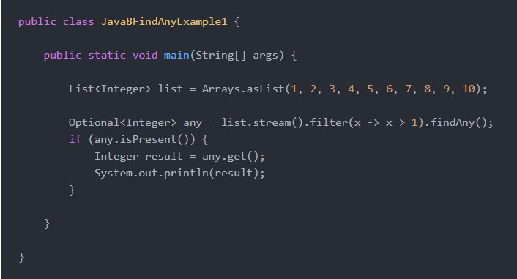
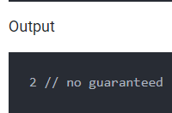
More streams and lambda expression examples
Example 2-find any:
Get any matching condition object in a list

Slide 20
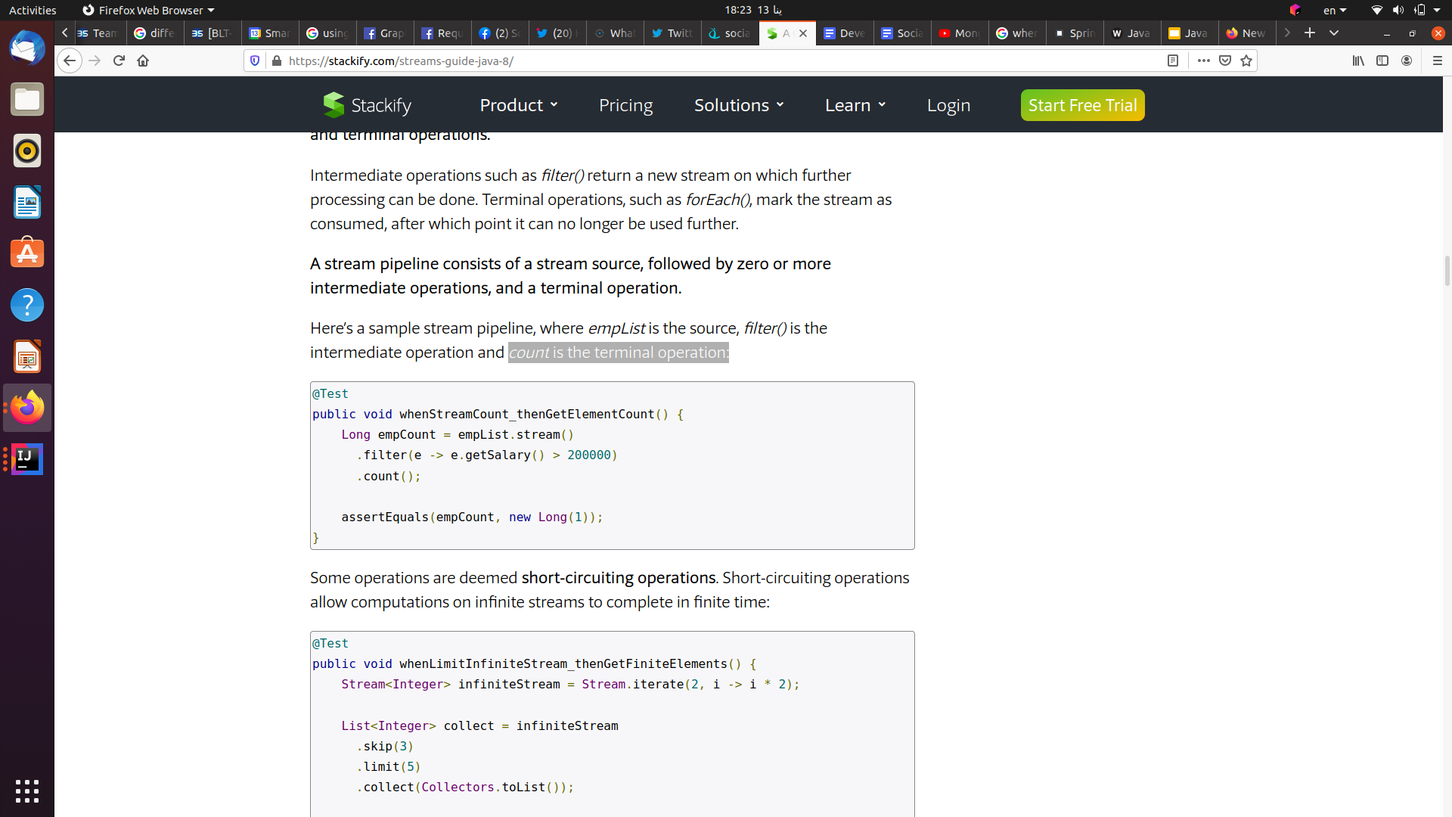
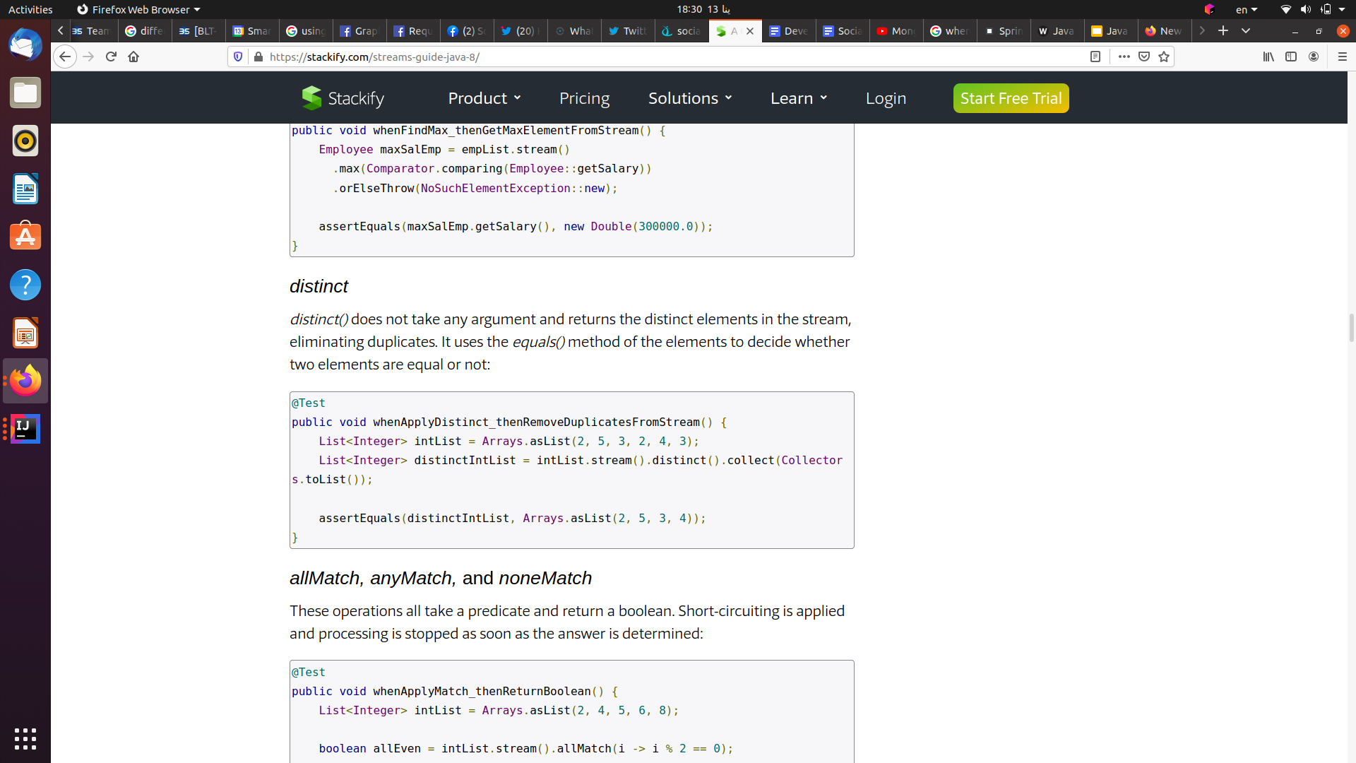
More streams and lambda expression examples
Example 3:
Get count of elements in list that matching certain condition:
Same way for min and max
Example 4:
Get count of elements in list that matching certain condition:

Slide 21
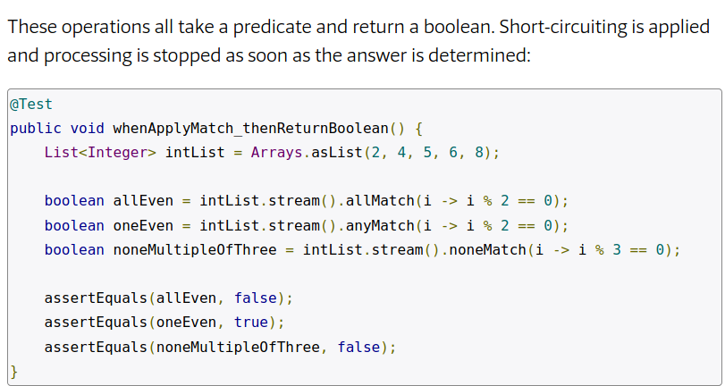
More streams and lambda expression examples
Example 5:
allMatch, anyMatch, and noneMatch:

Slide 22
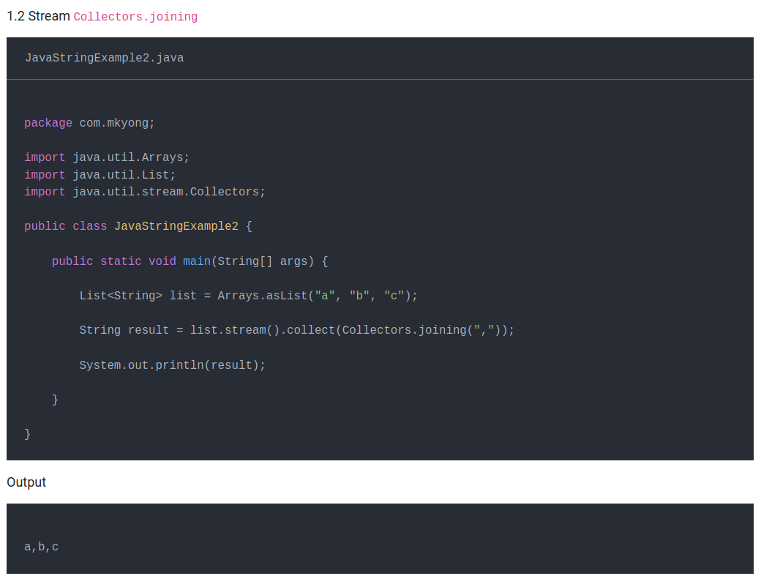
More streams and lambda expression examples
Example 6:
Joining by any delimiter in list of strings (Convert a List to a Comma-Separated String)

Slide 23
References
https://www.logicbig.com/tutorials/core-java-tutorial/java-util-stream/stream-api-intro.html
https://cheatography.com/carlmig/cheat-sheets/java-8-streams/
https://www.baeldung.com/java-8-streams
https://javaconceptoftheday.com/collections-and-streams-in-java/
https://mkyong.com/java8/java-8-stream-findfirst-and-findany/

